Slide 1
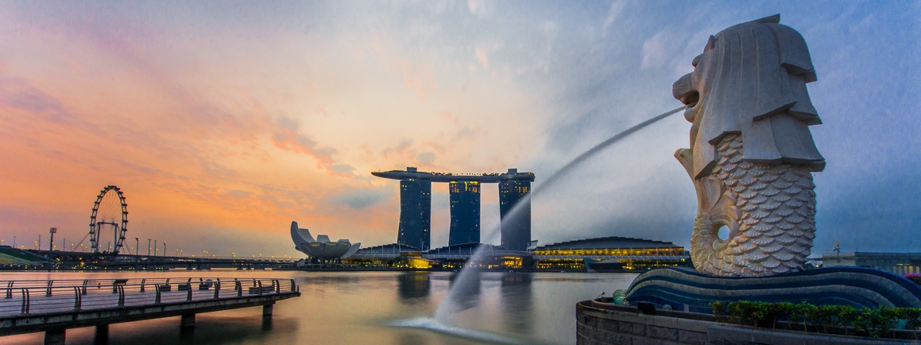
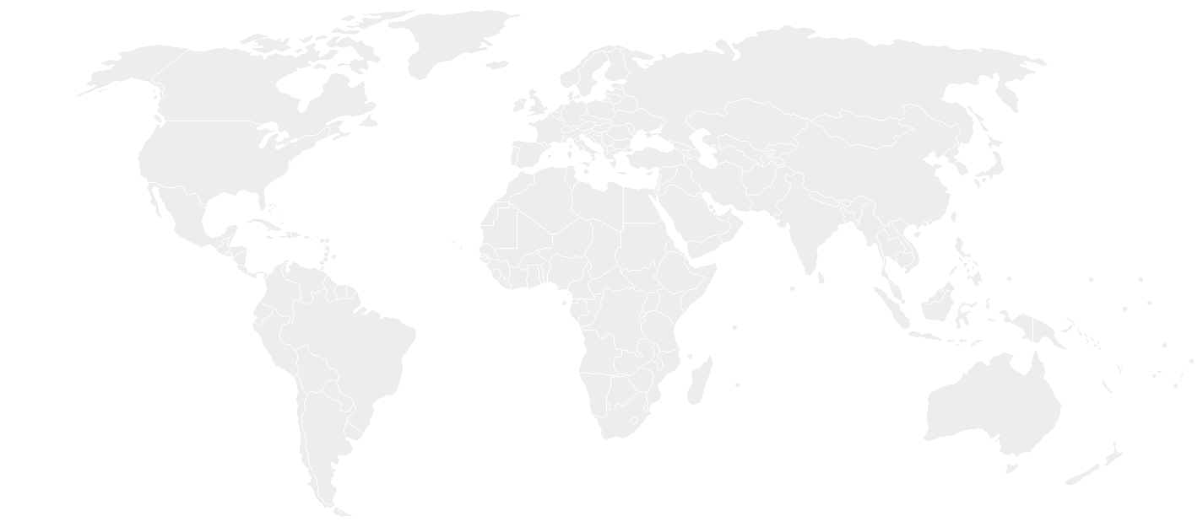
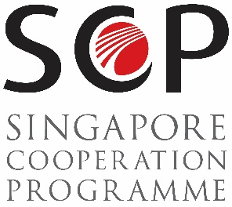
Notes:
Good afternoon Ladies and Gentleman. Thank you for giving me the floor. My name is Mitchel Lee, Deputy Director of International Programmes, Technical Cooperation Directorate, of the Singapore Ministry of Foreign Affairs. Today, I will be presenting on the Singapore Cooperation Programme, otherwise known as the SCP.

Slide 2
Outline
Overview SCP Calendar SCP and the SDGs South-South and Triangular Cooperation
What is SCP?
Facts and Figures of SCP
SCP Training Calendar
SCP and the SDGs
South-South and Triangular Cooperation
Q&A
Notes:
The outline of today’s presentation is as shown.

Slide 3
What is the SCP? ?
Overview SCP Calendar SCP and the SDGs South-South and Triangular Cooperation
Main avenue for Singapore to give back to the international community
Founded on belief that HRD is key to nation building and essential for sustainable development.
Notes:
The SCP is Singapore’s main avenue to provide technical assistance to fellow developing countries from the South.
In Singapore’s early years, we benefitted from technical assistance from International Organisations (IOs) and developed countries such as Japan.
As Singapore progressed, we decided to set up the SCP in 1992 as our way of paying it forward by giving back to the international community.
SCP’s focus is on human resource development as we believe that this is key to nation-building and essential for sustainable development.

Slide 4
What is the ?
Overview SCP Calendar SCP and the SDGs South-South and Triangular Cooperation
Platforms
South-South Cooperation
Bilateral programmes
Regional programmes – e.g. Initiative for ASEAN Integration, Asia-Middle East Dialogue, Small Island Developing States, CARICOM
Triangular Cooperation
Third Country Training Programmes – e.g. partnerships with TICA, TIKA, KOICA, JICA, USA,
Partnerships with International Organisations – UNDP, UN-Habitat, UNICEF, IMF, IAEA, UNODC
Notes:
This slide shows the various avenues in which we conduct programmes under the SCP. We conduct capacity-building quite often on a bilateral basis upon request from developing countries. We also conduct training programmes mean for a group of countries like ASEAN , SIDS, Latin America, and the Caribbean. We also have what we call TCTPs which are partnerships with major donor countries and their aid agencies. This neatly fits into the traditional definition or framework of trilateral cooperation (DAC countries, “pivotal countries” and beneficiary countries). Another form of trilateral cooperation is our partnerships with international organisations like the UN agencies.

Slide 5
What is the ?
Overview SCP Calendar SCP and the SDGs South-South and Triangular Cooperation
What do we mean by capacity-building?
SCP Calendar Courses
Customised Training/Programmes
Scholarships for Masters’ Programmes
Advisory/Consultancy
Vocational Training
Train-the-Trainer Programmes
Notes:
These are some of the kinds of programmes we conduct under the SCP.

Slide 6
SCP Facts and Figures
Overview SCP Calendar SCP and the SDGs South-South and Triangular Cooperation
120,000 participants since 1992
Involving 170 countries and territories
Working with more than 40 partners
300-400 programmes/year
Notes:
Since 1992, we have welcomed more than 120,000 participants for our SCP programmes.
They come from more than 170 countries and territories. We work with more than 40 partners to deliver our programmes.
Each year, the SCP conducts an average of 300 courses for more than 6,000 participants.

Slide 7
SCP TRAINING CALENDAR FY 2018
Overview SCP Calendar SCP and the SDGs South-South and Triangular Cooperation
Thematic Areas of Capacity-Building
 | Leadership and Good Governance
 | Connectivity (Maritime, Civil Aviation & Trade)
 | Education
 | Resilient Societies
 | Smart Nation
 | Sustainable Development
Notes:
Let me take the opportunity to introduce one of our core programmes - the SCP Training Calendar.
There is a copy of the 2018/19 Training Calendar in front of you, which we publish yearly. These are the six clusters covered by our training calendar this year. As you can see, the themes reflect some of the strengths which Singapore has built up over time.
The courses are open to government officials from developing countries. As we limit each of these courses to around 30 people, we typically receive an overwhelming response for them. There is a selection process which includes (i) endorsement from their respective Governments or National Focal Points of Technical Assistance, (ii) relevance of the course to their positions in government and (iii) ensuring a good distribution of participants from around the world.

Slide 8
SCP and the SDGs
Overview SCP Calendar SCP and the SDGs South-South and Triangular Cooperation
The SCP supports the efforts of developing countries to implement the UN 2030 Agenda for Sustainable Development and its 17 Sustainable Development Goals (SDGs).
Notes:
The annual SCP Training Calendar supports the UN 2030 Agenda for Sustainable Development and its 17 Sustainable Development Goals (or SDGs). We try to ensure that our courses help to promote one or more of the SDGs.
If you flip through the calendar, you will see that we have tagged each course to a specific SDG. We strongly believe that the SDGs are a useful road map and tool for countries in their development journey. At the same time, each country will have to adapt to their own circumstances and situation as they see fit.

Slide 9
Sustainable Development Programme
Overview SCP Calendar SCP and the SDGs South-South and Triangular Cooperation
5-day leadership workshops “Transformational Leadership for the 2030 Agenda” (SDG 16)
Multi-year programme for mayors and city planners on sustainable cities (SDG 11)
Ground project with NGOs and capacity-building programme with UNICEF (SDG 6)
Notes:
Let me now share a few recent developments in our south-south and triangular cooperation under the SCP. Since 2015, and the launch of the UN 2030 Agenda, Singapore launched our Sustainable Development Programme (SDP) package to offer new modes of assistance that promote south-south and triangular cooperation. For example, one component of this programme is collaborating with non-government actors to conduct ground-level activities that support sustainable development.

Slide 10
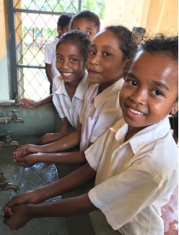
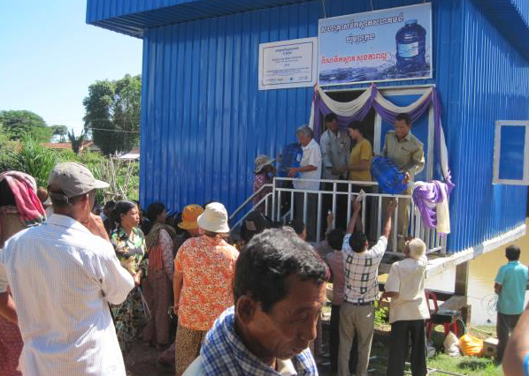
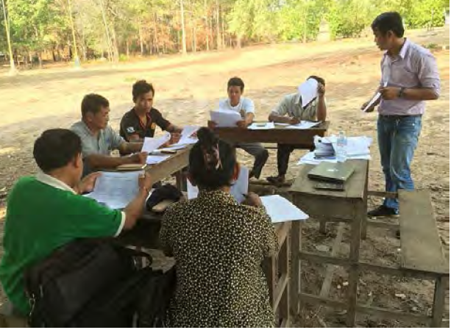
South-South and Triangular Cooperation
Overview SCP Calendar SCP and the SDGs South-South and Triangular Cooperation
Local-level projects with NGOs
In Myanmar, Cambodia, and Timor-Leste
Enable villagers to be more self-sustainable in terms of water security and water, sanitation & hygiene (wash) awareness
Water Treatment Plant in Cambodia set up by Lien Aid
Training at Commune Level on usage of water treatment facility
Children washing hands after recess in Timor-Leste
Notes:
For example, the Singapore Government is now supporting two of our local NGOs , Mercy Relief and Lien Aid to provide water solutions to villagers. Around (how many) villagers have benefitted so far in villages in Cambodia, Myanmar and Timor-Leste.

Slide 11
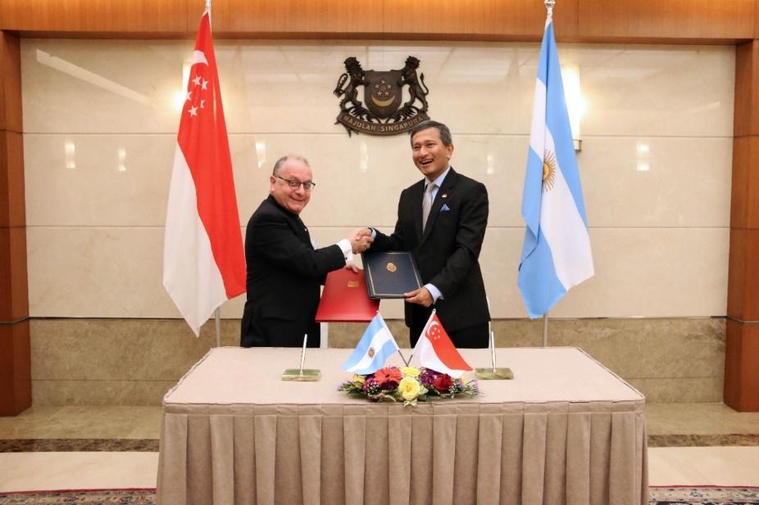
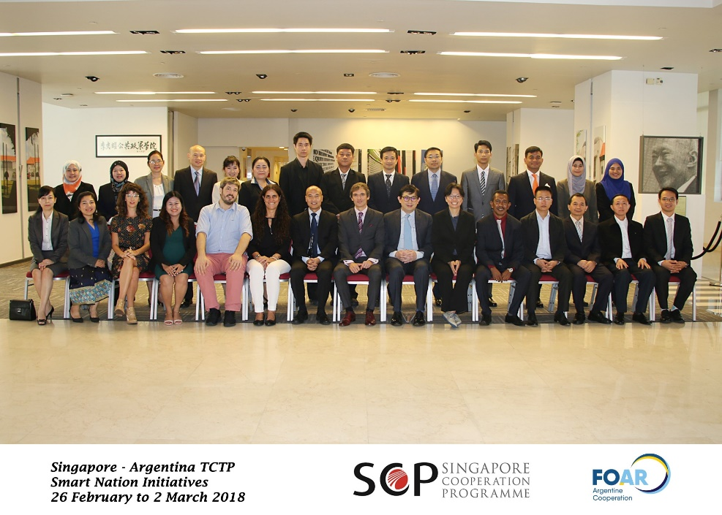
South-South and Triangular Cooperation
Overview SCP Calendar SCP and the SDGs South-South and Triangular Cooperation
MOU signing on 4 Sep 2017 by Foreign Ministers
Notes:
Another example of how we have been innovative in our approach towards fostering South-South and Triangular Cooperation is Singapore’s recent partnership with Argentina to help the South. Last year, Singapore signed an MOU with Argentina on Technical Cooperation to share our respective strengths in areas such as Smart Nation Initiatives, and Food Safety.
We started off with a pilot course on “Smart Nation Initiatives” which was held in Singapore.
This course brought together experts and trainers from Singapore’s Lee Kuan Yew School of Public Policy and Argentina’s Ministry of Modernisation to share their experience with 22 participants from the Southeast Asian region. We are working toward hosting another programme on “Smart Nation Initiatives” in Buenos Aires , this time for South American participants.

Slide 12
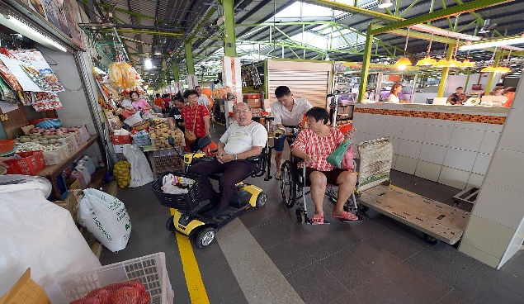
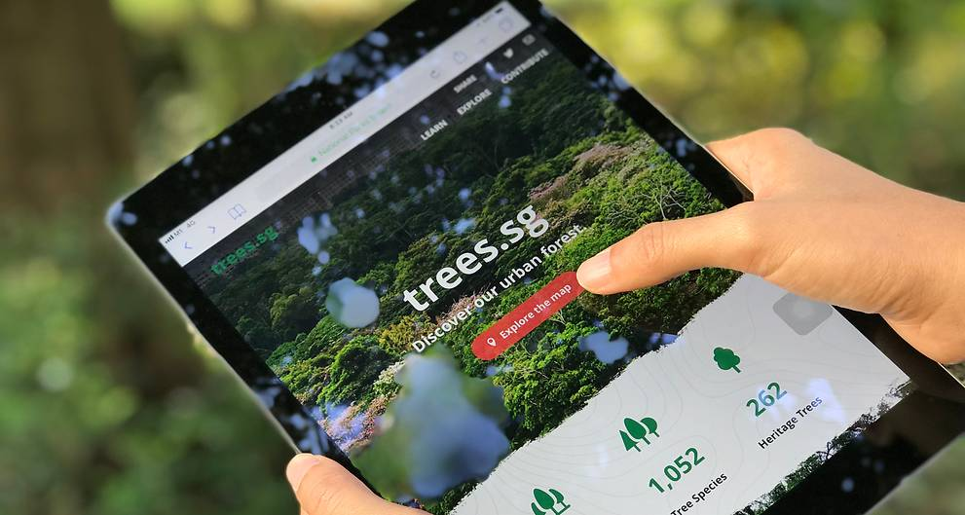
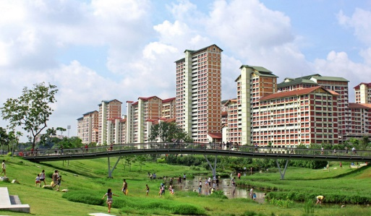
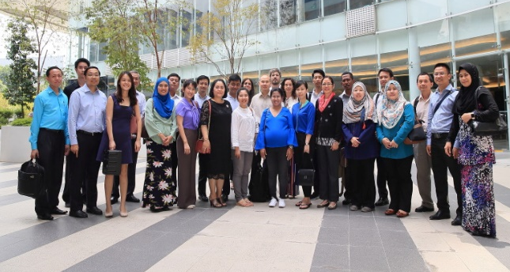
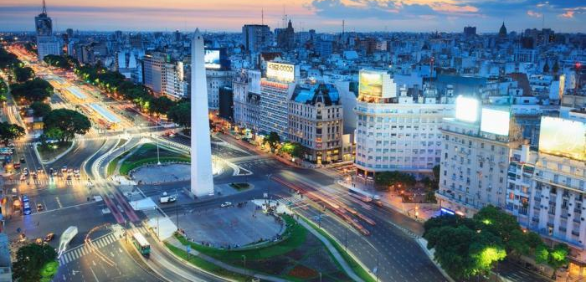
South-South and Triangular Cooperation
Overview SCP Calendar SCP and the SDGs South-South and Triangular Cooperation
Making Estates more Inclusive and Elderly-Friendly
Being Green is Smart!
Insights on Liveability
Citizen-centric Digital Services
Building a Knowledge Economy
Smart City: Perspective from Argentina
Notes:
The goal of this course was to leverage on technological solutions for sustainable development, by providing participants with good insights on how to facilitate effective collaboration among governmental organisations, experts, and private sector actors, to implement holistic and integrated solutions through site visits, discussions, and presentations.
The course included sessions on making estates more inclusive and elderly-friendly, smart solutions on going green and urban liveability, creating citizen-centric digital services, site visits to relevant agencies, and perspectives from Argentina.
Although Argentina is from a different continent, there are common challenges that we share, and there is much that we can learn from each other. The Argentinian/Latin American perspective was also useful to augment our ASEAN experience. Many participants found Argentina’s perspective refreshing.

Slide 13
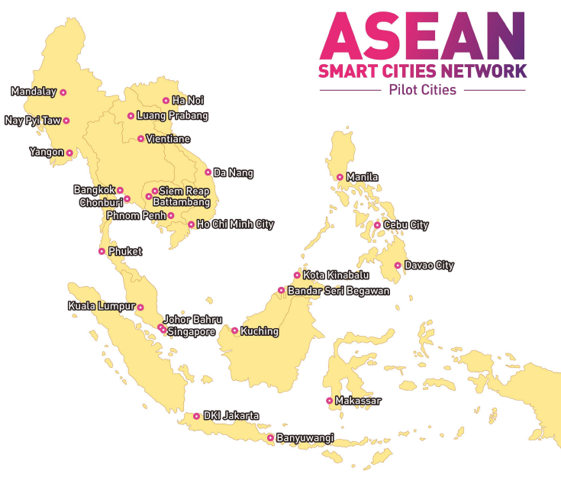
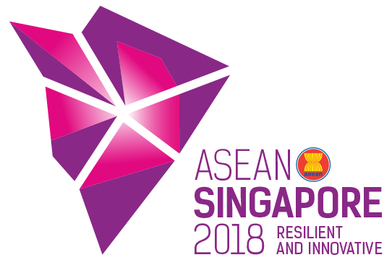
Notes:
This brings me to the next exciting initiative which will be launched very soon - the ASEAN Smart Cities Network or ASCN.
ASEAN’s urban centres are the drivers of regional economic growth
By 2030, 90 million more people are expected to urbanise
Rapid urbanisation has implications on issues such as congestion, water/air quality, and income inequality
Technology can help to resolve some of these issues
This year, as Chair of ASEAN, Singapore has proposed to establish the ASEAN Smart Cities Network (ASC) to develop a smart cities ecosystem in the region
This synergises the ongoing efforts by individual ASEAN Member States to develop smart and sustainable urbanisation
Its primary goal is to improve the lives of ASEAN’s people, using technology as an enabler.
ASEAN’s external partners will also participate through a “twinning programme”, which aims to pair each ASCN member city up with an external partner to facilitate mutually beneficial cooperation on smart cities developments
External partners include the 10 dialogue partners, multilateral institutions such as World Bank will be invited to join as well. The commitment provided to the region will also help to scale up triangular cooperation.
With this, 26 cities from the 10 ASEAN countries will officially form the pioneer batch of ASCN.

Slide 14
ASEAN Smart Cities Network - Key Events
Overview SCP Calendar SCP and the SDGs South-South and Triangular Cooperation
Smart Cities Governance Workshop (SCGW) - 22 to 25 May 2018
Discuss the ASEAN Smart Cities Framework
Craft city-specific Action Plans
Networking Session between ASCN member cities and ASEAN’s external partners
Inaugural Meeting of the ASCN - 8 July 2018 (alongside World Cities Summit)
Official launch of ASCN
33rd ASEAN Summit in November 2018
ASEAN Leaders formally adopt the ASCN Framework and note the member cities’ action plans
Finalised list of project partnerships noted by Leaders
Beyond 2018
ASCN moves to implementation phase
ASCN will meet annually to monitor the progress of implementation
Possibility of expansion as ASCN matures
Notes:
Key events to kick off the ASCN are:
The Smart Cities Governance Workshop from 22-25 May, which will discuss the framework and craft city-specific action plans.
Inaugural Meeting of the ASCN on 8 July alongside the World Cities Summit in Singapore – to officially launch the network and meet with ASEAN’s external partners

Slide 15
Thank you!
Notes:
With that, I have come to the end of my presentation. Thank you.

