Slide 1
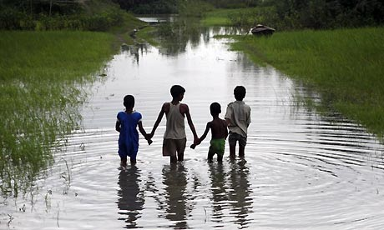
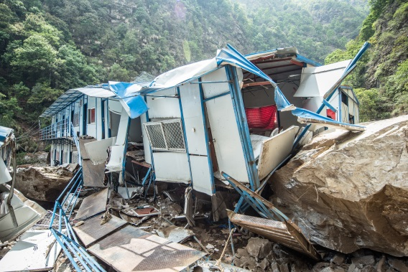
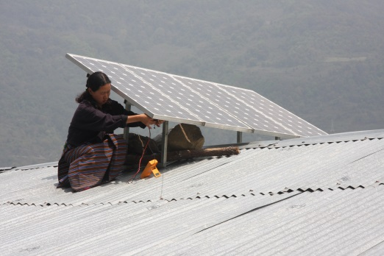
Asian Development Bank
Carbon Market Program

Slide 2
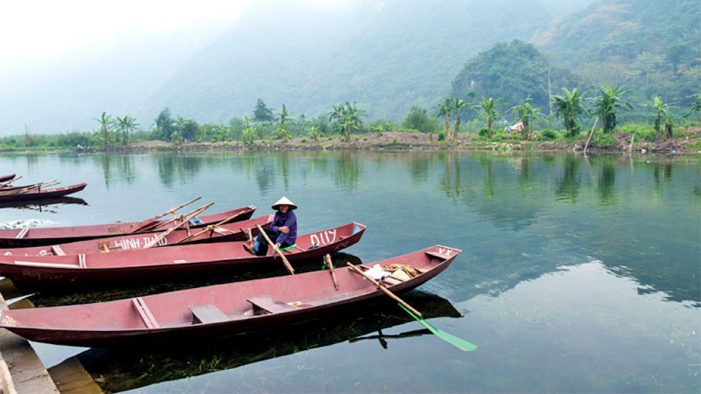
Outline
Carbon Market Program
Carbon finance
Technical support
Article 6
JFJCM
Decoding Article 6
Building on experience from CDM
- FCF: Sustainable Development Impacts

Slide 3
ADB Approach to Climate Finance Mobilization
Deploying concessional resources
Maximizing
market mechanisms
Catalyzing
private capital
Internally managed resources (ADB donor trust funds and special funds)
Climate Change Fund (CCF)
Clean Energy Financing Partnership Facility (CEFPF)
Urban Climate Change Resilience Trust Fund (UCCRTF)
Asia-Pacific Climate Finance Fund (ACliFF)
High Level Technology Fund (HLTF)
Others with bilaterals
Multilateral funds
Climate Investment Funds (CIF)
Global Environment Facility (GEF)
Green Climate Fund (GCF)
Upfront carbon finance
Asia Pacific Carbon Fund
Future Carbon Fund
Carbon Market Technical Support Facility
CDM support
domestic emissions trading
Japan Fund for the Joint Crediting Mechanism
Green and Climate Bonds
Supporting other market mechanisms (e.g. renewable energy credits; feed-in tariffs)
Direct project finance (lending, guarantees, syndications), and equity investment
Public private partnerships: (PPPs) working with client DMCs across stages of PPPs

Slide 4
ADB’s Carbon Market Program
Technical Support Facility
Asia Pacific Carbon
Future Carbon Fund
Japan Fund for the Joint Crediting Mechanism
Commenced in 2006
Implemented through a series of 5 Technical Assistance projects
TA 6363: Preparing Clean Energy Projects Eligible for the Clean Development Mechanism
TA 6438: Implementation of the Technical Support Facility under the Carbon Market Initiative
TA 8223: Supporting the Use of Carbon Financing to Promote Green Growth in Asia and the Pacific
TA 8654: Supporting the Use of Carbon Financing from New Carbon Market Mechanisms to Promote Green Growth in Asia and the Pacific
TA 9062: Supporting Low-Carbon Development in Asia and the Pacific through Carbon Markets
$151.8 million Trust Fund to purchase pre-2013 CERs
Commenced in 2007
Fund Participants include Seven European Governments
Supported 71 CDM projects in 9 DMCs
Contracted 15.63 million CERs
Provided carbon finance to 1.9 GW renewable energy projects
All contracted CERs received and distributed to Fund Participants
Fund closed in 2014
$115 million Trust Fund to purchase post-2012 CERs
Commenced in 2009
Fund Participants include Four Governments and two private sector entities from Europe and Asia
Contracted 10.6 million CERs as of 31 May 2018
Supporting 36 CDM projects in
12 DMCs
Providing carbon finance support to 1.2 GW renewable energy projects
Disbursed $42.3 million as of 31 May 2018
Fund will close in 2021
$51.7 million by MOEJ
Commenced in June 2014
JFJCM provides financial incentives for adoption of advanced low-carbon technologies in ADB-financed projects
Grant to sovereign projects (max. $10 million)
Interest subsidy to non-sovereign projects (max. $10m)
First project under implementation - smart micro-grid system in Maldives
Notes:
Governments typically favor immediately pressing demands yielding assured near-term benefits and generating positive streams of direct or indirect income in the allocation of resources

Slide 5
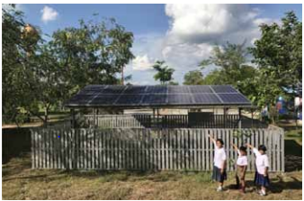
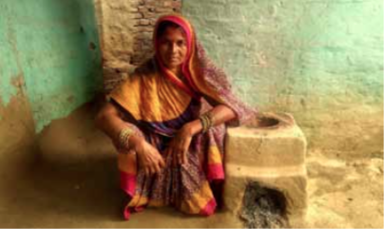
Future Carbon Fund
Start | 2009
Fund size | $115 million
Objective | To support and co-finance high quality GHG reduction projects in DMCs through purchase of post-2012 CERs; Upfront carbon financing
Fund Participants | The Ministry for Foreign Affairs of Finland (Finland); Swedish Energy Agency (Sweden); Participatie Maatschappij Vlaanderen NV (PMV) for Flemish Region of Belgium; Republic of Korea; POSCO; and Eneco Energy Trade
Achievement | 36 CDM projects of various low carbon technology 12 countries in Asia and the Pacific region (including 6 LDCs/ SIDS) $13.6 million (23%) co-finance support to the projects in LDCs/SIDS Carbon finance support to 1.2 GW renewable energy facilities
Notes:
Governments typically favor immediately pressing demands yielding assured near-term benefits and generating positive streams of direct or indirect income in the allocation of resources

Slide 6
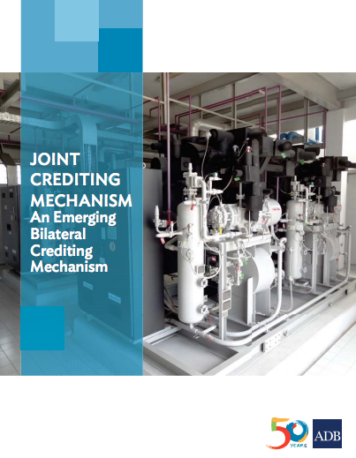
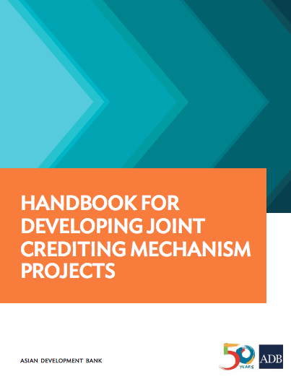
Japan Fund for Joint Crediting Mechanism
Established | June 2014
Funding | $51.7 million contributed by MOEJ
Objective | JFJCM provides financial incentives for adoption of advanced low-carbon technologies in ADB-financed projects
Support provided | Grant to sovereign projects (max. $10 million) Interest subsidy to non-sovereign projects (max. $10m)
Solar Power Project in Maldives | Additional financing approved by ADB in March 2015 Install advanced battery system and energy management system (EMS) for smart micro-grid system
Wastewater treatment plant in Cambodia | Financing approved by ADB in December 2017 Build an energy efficient wastewater treatment plant in Battambang
Notes:
Governments typically favor immediately pressing demands yielding assured near-term benefits and generating positive streams of direct or indirect income in the allocation of resources

Slide 7
Technical Support Facility
Emissions Trading Systems
Thailand
Providing technical and capacity development support to the Thailand Greenhouse Gas Management Organization (Public Organization)
Framework for policy decisions, most promising design options, and a roadmap for developing a domestic ETS in Thailand
Viet Nam
Providing technical and capacity development support to the Ministry of Natural Resources and Environment (MONRE)
Strengthening the robustness of the GHG inventory system
Capacity enhancement for the line ministries and economic players to build the inventory, data collection methodologies and learning from other countries
Notes:
Governments typically favor immediately pressing demands yielding assured near-term benefits and generating positive streams of direct or indirect income in the allocation of resources

Slide 8
Technical Support Facility
Emissions Trading Systems
ETS Knowledge Sharing Platform (ETS-KSP)
Partnership with the International Carbon Action Partnership (ICAP) to support development and linking of domestic ETS in Asia Pacific region
Platform for key policy makers and stakeholders to interact periodically to exchange knowledge and learn from each other’s experiences in developing / implementing ETS
Participants from PRC, Indonesia, Japan, Kazakhstan, Republic of Korea, New Zealand, Philippines, Singapore, Thailand, and Viet Nam
Notes:
Governments typically favor immediately pressing demands yielding assured near-term benefits and generating positive streams of direct or indirect income in the allocation of resources

Slide 9
Decoding Article 6
ADB knowledge product providing understanding of:
The potential scope of cooperative approaches and the new mechanism for mitigation and sustainable development
Centralized vs. decentralized governance
Transparency
Environmental integrity
Definitions of ITMO
Capacity development – Technical workshops for negotiators on understanding Article 6
Manila
Bangkok

Slide 10
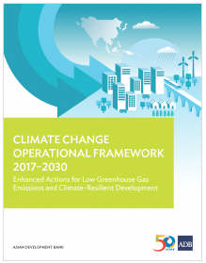
NDC Implementation
ADB Strategy 2030 responds to the changes in the rapidly evolving Asia and the Pacific
Developed CCOF 2017-2030, strengthens support to DMCs
CCOF 2030 will be implemented through an action agenda consisting of 2 operational phase
Phase 1 (2017-2023)
Phase 2 (2024-2030)

Slide 11
Sustainable Development Impacts
In 2017, ADB released the report “Future Carbon Fund – Delivering Co-Benefits for Sustainable Development”
FCF include 36 CDM projects in 12 developing countries in Asia
Projects were assessed using a methodology to track social, environmental, and economic impacts
FCF supported projects provide a broad set of co-benefits to the beneficiary communities

Slide 12
Lessons Learned
Project design that maximizes co-benefits
Importance of dialogue with local communities in the decision-making
Corporate philosophy of the project entities
Smart domestic policies bring synergy for multiple co-benefits
Incentivize high-quality mitigation projects
Inclusion of co-benefits in the emission reduction purchase agreement
Secured stream of carbon finance.

Slide 13
V.K. Duggal Principal Climate Change Specialist Fund Manager - Future Carbon Fund Sustainable Development and Climate Change Department Asian Development Bank vkduggal@adb.org www.adb.org
https://www.adb.org/themes/climate-change-disaster-risk-management/main
https://www.adb.org/climate-change-financing

